Slide 1
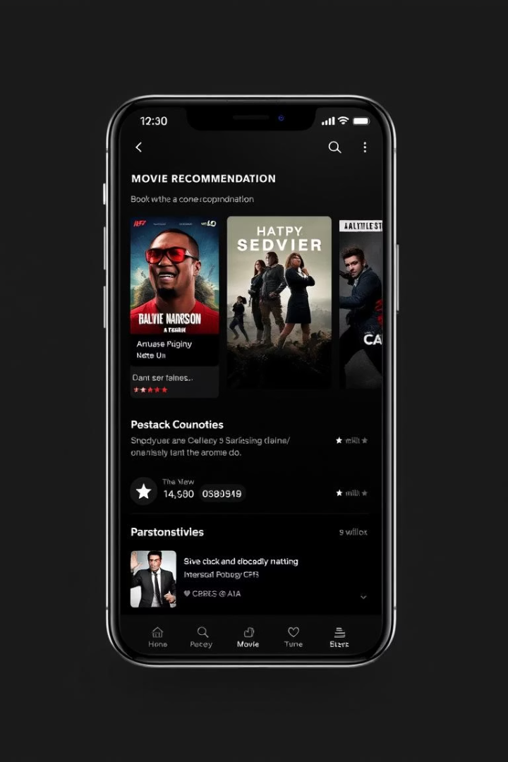

Movie Recommendation System using Content-Based Filtering
This presentation outlines the creation of a B.Tech CSE project. It focuses on a movie recommendation system employing machine learning and AI. We leverage content-based filtering to provide personalized movie suggestions.
by Kuldeep Bahuguna

Slide 2
Introduction: The Rise of Recommendation Systems
The Digital Age
Netflix
Amazon
Recommendation systems are vital in today's digital environment. They shape user choices and drive sales across platforms.
75% of viewing choices are driven by recommendations. This highlights the system's importance for user engagement.
35% of sales come from recommendation algorithms. They significantly boost revenue generation.

Slide 3

Project Goal and Objectives
1
Develop a Content-Based System
2
Implement Machine Learning
3
Evaluate Performance
Assess accuracy to provide users with relevant movie suggestions.
Our goal is to create a movie recommendation system based on content.
We will use ML for feature extraction and personalized suggestions.

Slide 4
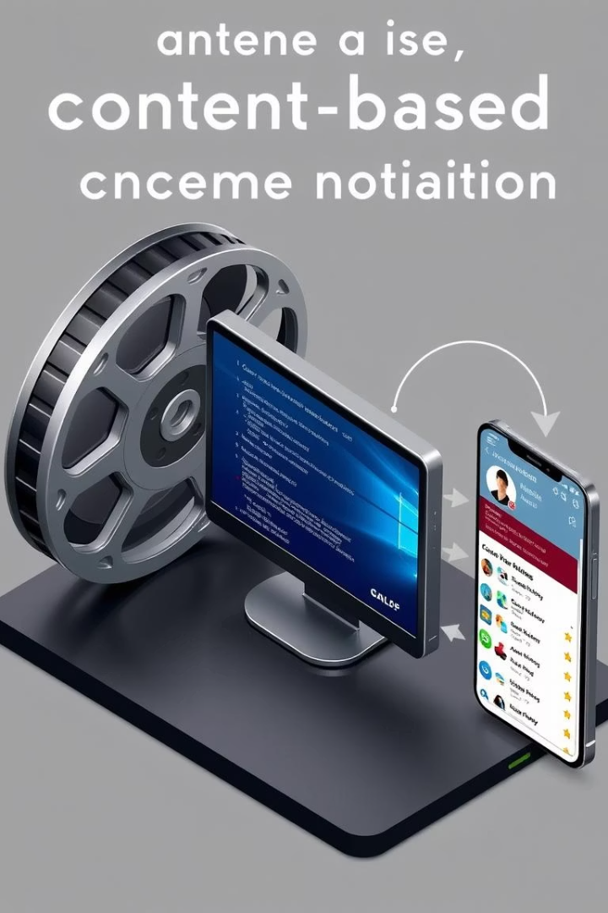
Content-Based Filtering: Core Concepts
Matching User Profiles
Key Components
Content-based filtering matches user profiles to movie content.
Movie features and user profiles are essential for accurate recommendations.
Analyzing Metadata
The system identifies similar films by analyzing movie metadata.

Slide 5
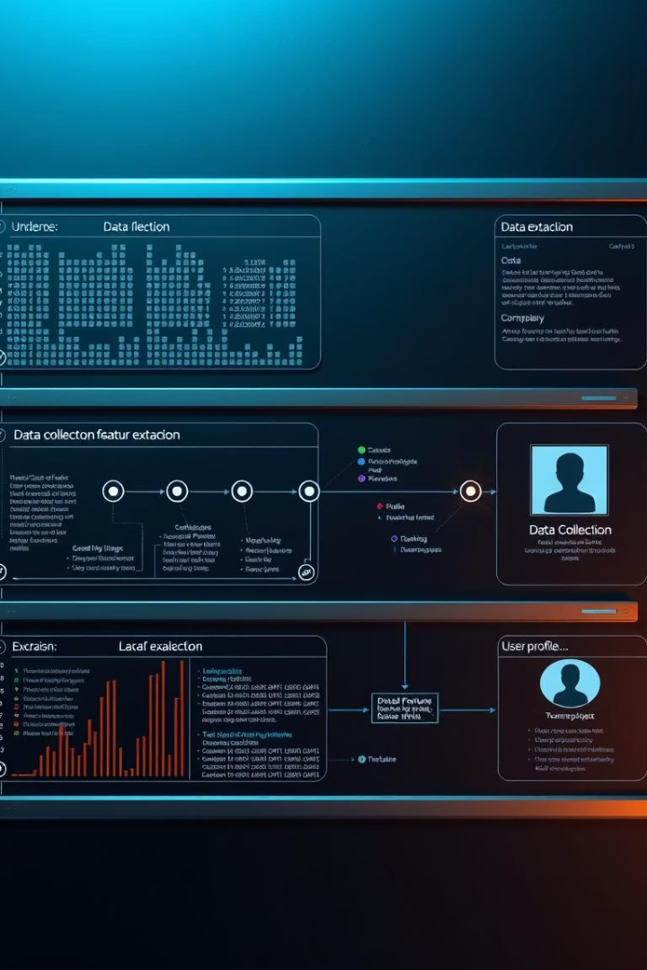



Project Implementation: Step-by-Step
Data Collection
Feature Extraction
User Profile Creation
Gather data from IMDb and TMDB including titles, genres, and plots.
Identify key movie attributes using TF-IDF and embeddings.
Build profiles based on viewing history and explicit ratings.

Slide 6


Machine Learning Algorithms: Building the Model
Recommendation Generation
Similarity Calculation
Measure similarity between movies using Cosine similarity.
1
2
Suggest movies based on their similarity to user-liked movies.

Slide 7
Technology Stack and Tools
Python
1
2
Scikit-learn
Pandas, NumPy
3
4
Matplotlib, Seaborn
MongoDB, PostgreSQL
5

Slide 8
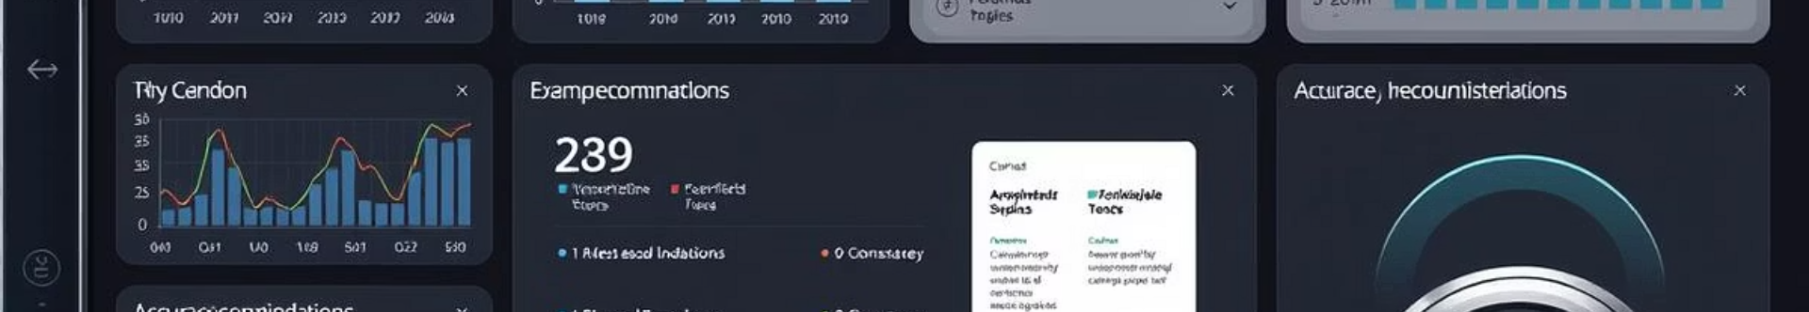



Evaluation and Results
Evaluation Metrics
We used Precision, Recall, and F1-score.
Sample Results
The system provides relevant suggestions for specific users.
Accuracy
Achieved a precision of 78% on the test dataset.

Slide 9



Project Applications and Future Scope
1
Personalized Platforms
2
Enhancing Discovery
3
Social Integration

Slide 10

Conclusion
Project Achievements
Successfully developed a content-based movie recommendation system.
Effectiveness
Demonstrated the effectiveness of content-based filtering.
Acknowledgments
Thank you to the team and contributors.

